Slide 1


Project Handoff
MotorCity Casino
2023 Cohort Team: Sonia Dai, Cassandra Kieta, Lingxiao Mou, Nathan Vanderweide, Donglin Yu
Faculty Mentor: Gail Hohner
Sponsor Mentor: Brian Pasmanter
Notes:
Nathan

Slide 2

Agenda
Headcount Modeling Results
Accuracy
What you can expect
Model Development
Random Forest Technique
Dataset
Variable selection
Detailed Model Performance
Recommended Next Steps
Q&A
Notes:
Nathan

Slide 3

Project Overview
Problem
Variable casino headcount poses challenges in efficient staff scheduling, impacting customer experience and operational costs
Objective
Develop a forecasting model for casino headcount
Significance
Increased operational efficiency
Cost savings
Resource optimization
Analytics and Planning
Enhanced customer satisfaction
Improved service delivery
Minimized wait times
Notes:
Nathan

Slide 4
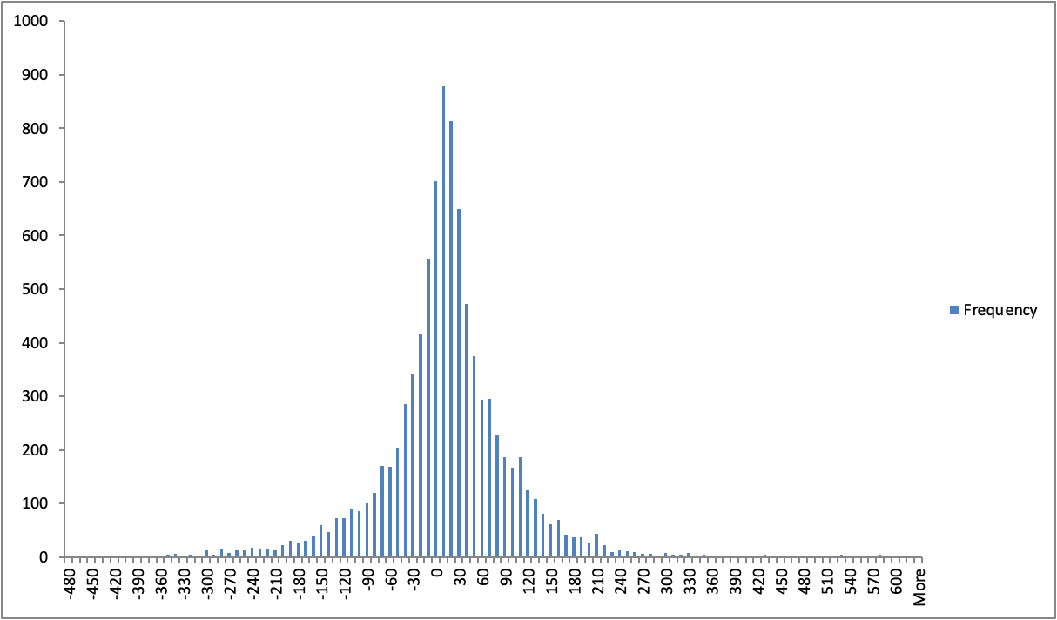
Distribution of Difference
Histogram of Actual - Predicted Slot Headcount
Zero Difference Indication Line
70.6% of data falls into the interval [-70, 70]
29.0% of data falls into the interval [-20, 20]
~75% of errors fall between [-70, 70]
~90% of errors fall between [-135, 135]
Frequency (Number of Hours)
Difference (Actual - Predicted Slot Headcount)
Notes:
Dio
Frequency to Number of observations
Distribution for training, 2022, 2023
Expect training distribution is tighter
The histogram of weekend / weekday /

Slide 5
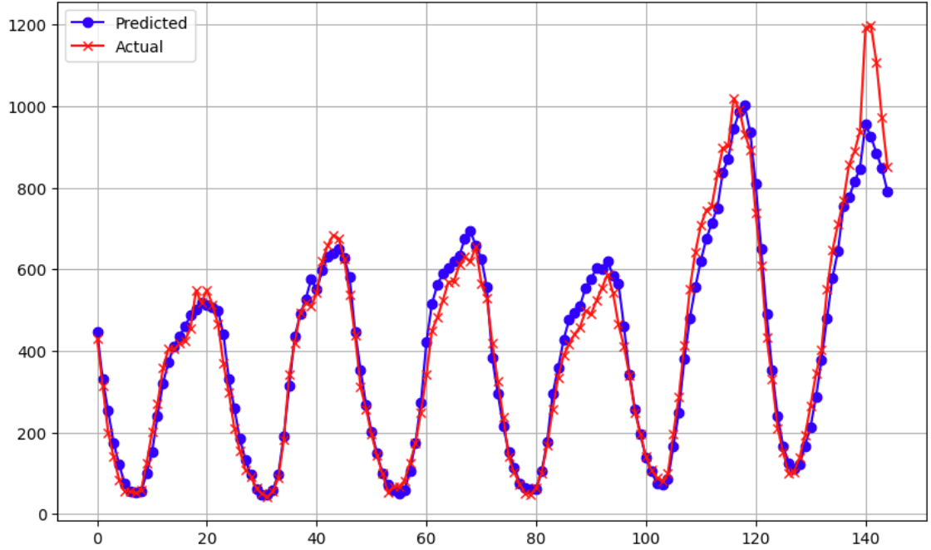
Model Results - Best Week
(2023-04-24 to 2023-04-30)
Apr.24 - Apr.30(Best Performance Week)
During one of our model’s best performing weeks, actual and predicted points are closely aligned, showing that the model consistently performed well this week. Overall our model was able to accurately capture the peaks and the valleys, resulting in an accurate forecast.
Headcount
0
20
40
60
80
100
120
140
Hour
April 24
April 30
Notes:
Donglin

Slide 6
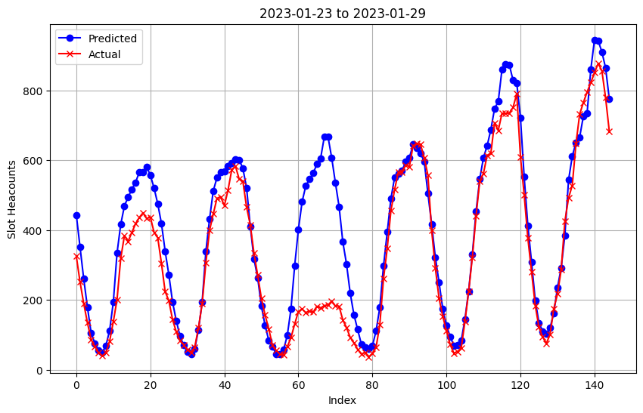
Model Results - Worst Week
(2023-01-23 to 2023-01-29)
Jan.23 to Jan.29(Worst Performance Week)
Bad Prediction Period
Worst performing weeks
Actual and predicted points are generally aligned in general, including busiest hours our model underpredicts.
Headcount
Headcount
Hour
0
20
40
60
80
100
120
140
Jan 23
Jan 29
Jan 23
Jan 29
Notes:
donglin

Slide 7

Background - Rejected Models
Rejected models:
Models that won’t work:
Gaussian Process Regression (GPR): decided to implement Random Forest instead
Trigonometric seasonality, Box-Cox transformation, ARIMA errors, Trend and Seasonal components (TBATS): low interpretability and high computation complexity
State space models: may result in explosion of number of state
Vector Autoregression (VAR): cannot handle exogenous variables
Multiclass Perceptron: not suitable for time series data
Recurrent Neural Networks (RNN): LSTM is the standard RNN for forecasting
Decision Tree: more prone to overfitting and worse performance than Random Forest
LightGBM: less documentation/community support available and comparable performance to XGBoost
Models that might work but did not investigate fully:
LASSO: Lack of understanding of how the model works
XGBoost: Similar model structure and results to Random Forest
Long Short-Term Memory (LSTM): difficult to implement with strong performance, high computational complexity and many hyperparameters
Notes:
Sandy

Slide 8
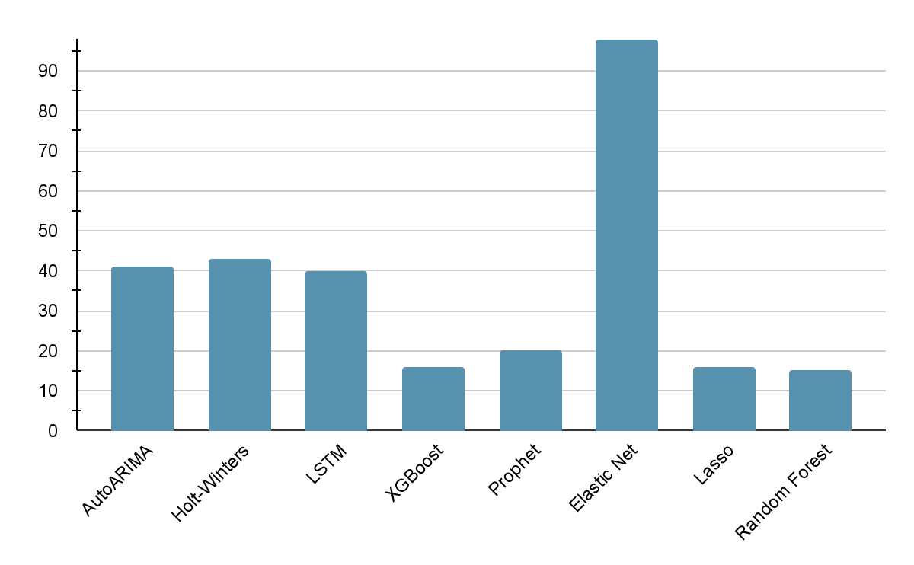
Background - Implemented Models
Model Performance
The higher the MAPE score, the worse the performance. Random Forest had the lowest error score, and therefore was the best performing model.
98.0
2-Week Slot MAPE* Score
41.0
43.0
40.0
20.2
15.8
16.0
15.0
*MAPE: Mean Absolute Percentage Error
Model
Notes:
Sandy

Slide 9
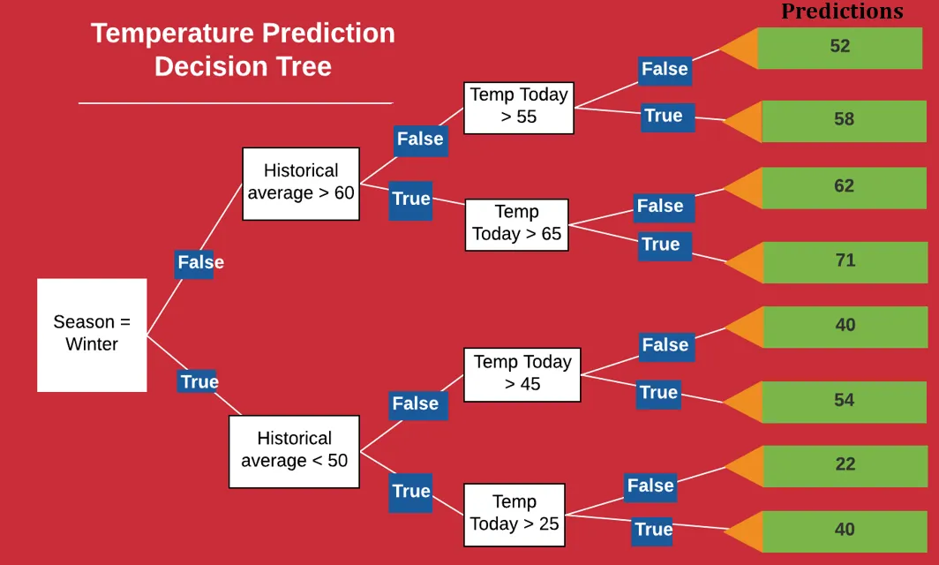
Decision Tree Illustration
Terminal Nodes
The root node represents the complete dataset
The node splits with a split criterion - which maximizes the information gain
Root Node:
Decision Node
Notes:
Sonia

Slide 10

Random Forest (RF) Description
Random Forest:
Consist of multiple, automatically generated decision trees
Each tree has a small number of nodes that split at a random number (usually the square root of the number of nodes)
The final prediction is the average of predictions from all trees
Pros:
Efficient on large datasets
High accuracy, robust on outliers
Cons:
Very little control in the tree structure and how the results are generated
Hyperparameters complexity
Notes:
Structure of a tree, plot show number of tree vs mape
sonia

Slide 11

RF model
Data Processing:
Ordinary encoding on categorical data
Lagging variables that cannot be retrieved in advance by three weeks
Parameters:
max_depth = 50
Maximum depth of the tree
max_features = 7
The maximum number of features when looking for the best split
min_samples_leaf =3
The minimum number of samples to be a leaf node
min_samples _split = 15
The minimum number of samples to split a node
n_estimators = 1000
Number of trees
Notes:
sonia

Slide 12

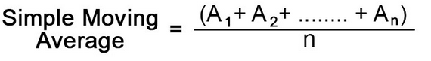
Data / Variables
All Variables Investigated:
Sponsor Data:
Table and slot headcount
Promotion (incl. Promo, Type, Cost, Revenue)
Hourly Coin-In, Games (Number of games played on slot machine)
Data Gathered by Students:
Monthly gas price
Detroit home and away sports games
US holidays
UM Consumer Sentiment Index
Weather
Construction / Road condition
Data Derived by Student:
Moving average of headcounts
Data Types:
Numerical and Categorical
Notes:
Data / variables selected
sonia

Slide 13
Data / Variables
Variables Used:
Sponsor Data:
Table and slot headcount
Promotion (Promo, Type, Cost, Revenue)
Hourly Coin-In, Games (Number of games played on slot machine)
Data Gathered by Student:
Monthly gas price
Detroit home and away sports games
US holidays
UM Consumer Sentiment Index
Weather
Construction / Road condition
Data Derived by Student:
Moving average of headcount
Data Types:
Numerical and Categorical
Notes:
Explain moving average calculation,sonia

Slide 14
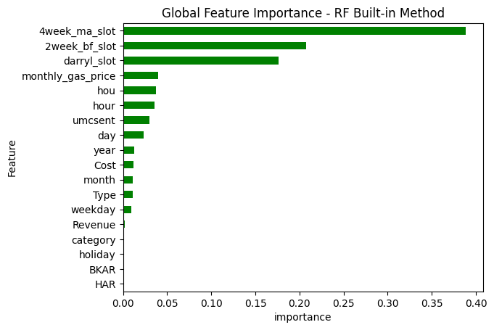
Data / Variables
Key Findings:
The most important features are the headcount moving averages.
The economic indicators such as gas price and consumer sentiments also contribute to the predictions.
2 weeks ago
12 week local average
Variable Explanation:
4week_ma_slot:
Average of prev 6~prev 2 week(4 week total) same hour headcount
2 weeks ago:
2 week before same hour headcount
12 week local average:
Average of prev 14~prev 2 week(12 week total) same hour headcount
Hou=Hour:
Hour of the day
Notes:
Nathan

Slide 15
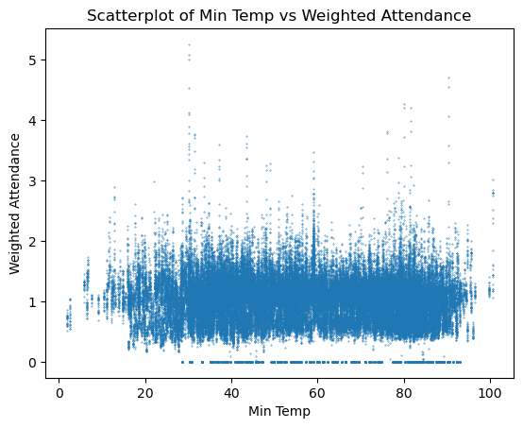

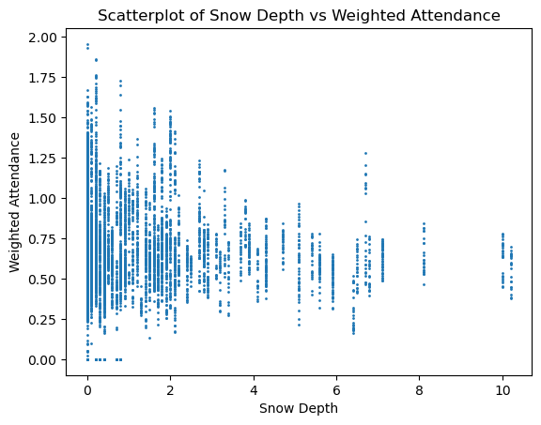
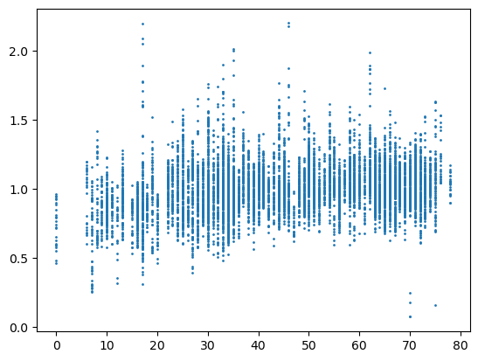
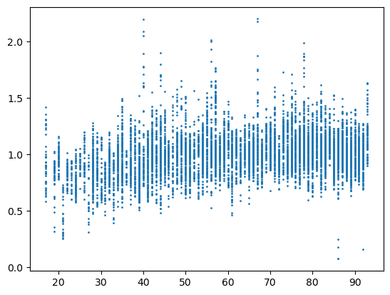
Temperature Correlation
There is a slight positive attendance correlation with temperature
Extreme cold temperatures (<5) see a drop in attendance on average
Extreme hot temperatures (>90) see an increase in attendance on average
Notes:
Nathan

Slide 16
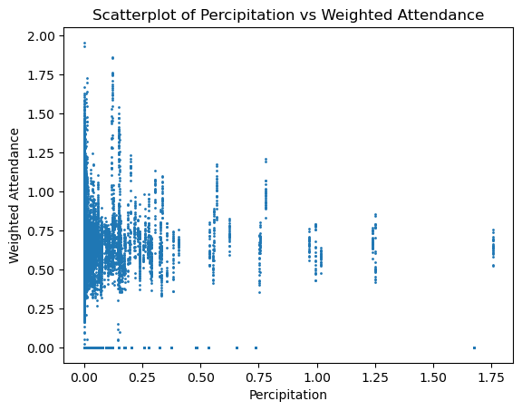
Other Weather Correlations
Snowfall - negative correlation Precipitation - low correlation
r = -0.147, r^2 = 0.022 r = -0.023, flat negative impact
Especially bad after 2.5 inches
Notes:
Nathan
Donglin
In this slide, we see the graph on the left showcasing our model's predictions from May 21 to June 3. Notice how closely the predicted values (in orange) mirror the actual headcount (in blue). This tight correlation suggests that during this period, our model was highly effective, likely due to stable patterns that the model learned well.
the graph on the right from February 26 to March 11 illustrates a period of less accurate predictions. The divergence between the actual and predicted values is significantly wider, which could indicate the presence of unforeseen factors that the model couldn't account for, or perhaps a shift in patterns not captured in the training data."

Slide 17


Developing the Model
Training period:
2018/01/01 - three weeks before the start of prediction period
Removed days casino closed (0 headcount days from 2020)
Prediction timeframe:
One week in the future
Runtime:
~ 10 minutes
Training
Prediction
Now (Week 0) - Week 2
2018/01/01
Week 3
Notes:
Donglin
In this slide, we see the graph on the left showcasing our model's predictions from May 21 to June 3. Notice how closely the predicted values (in orange) mirror the actual headcount (in blue). This tight correlation suggests that during this period, our model was highly effective, likely due to stable patterns that the model learned well.
the graph on the right from February 26 to March 11 illustrates a period of less accurate predictions. The divergence between the actual and predicted values is significantly wider, which could indicate the presence of unforeseen factors that the model couldn't account for, or perhaps a shift in patterns not captured in the training data."

Slide 18
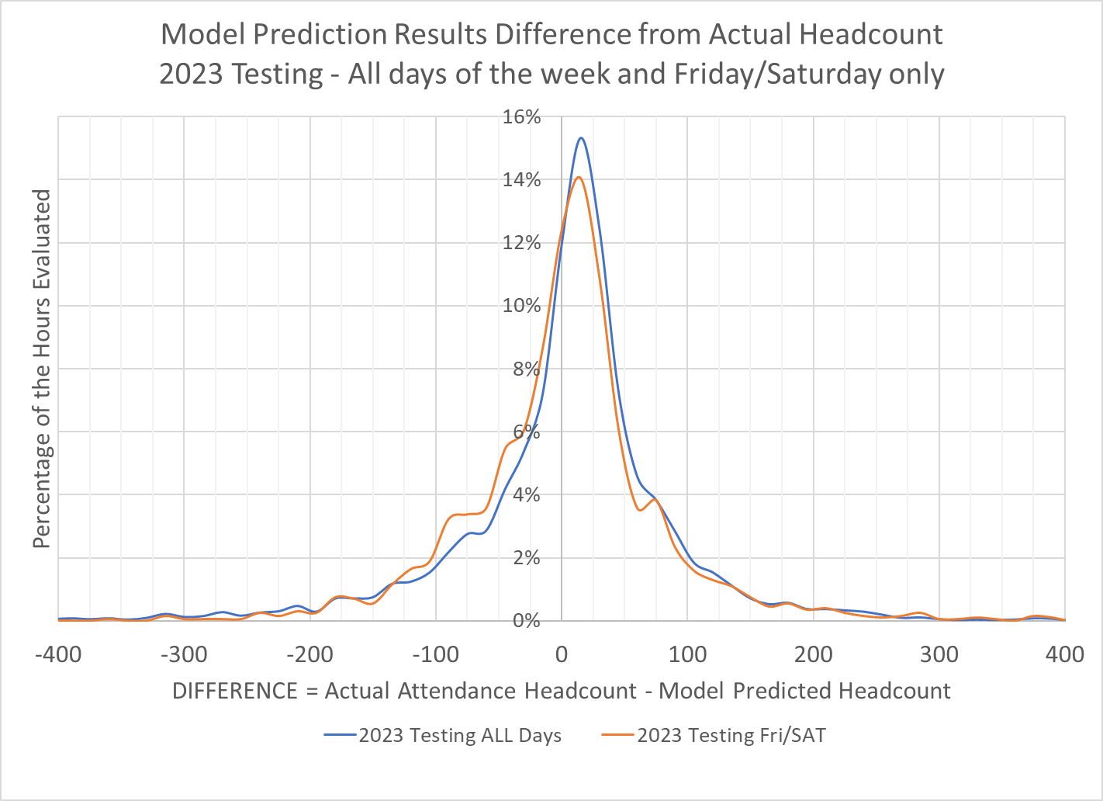
Distribution of Difference
Histogram of Actual - Predicted Slot Headcount
Notes:
Frequency to Number of observations, dio
Distribution for training, 2022, 2023
Expect training distribution is tighter
The histogram of weekend / weekday /

Slide 19
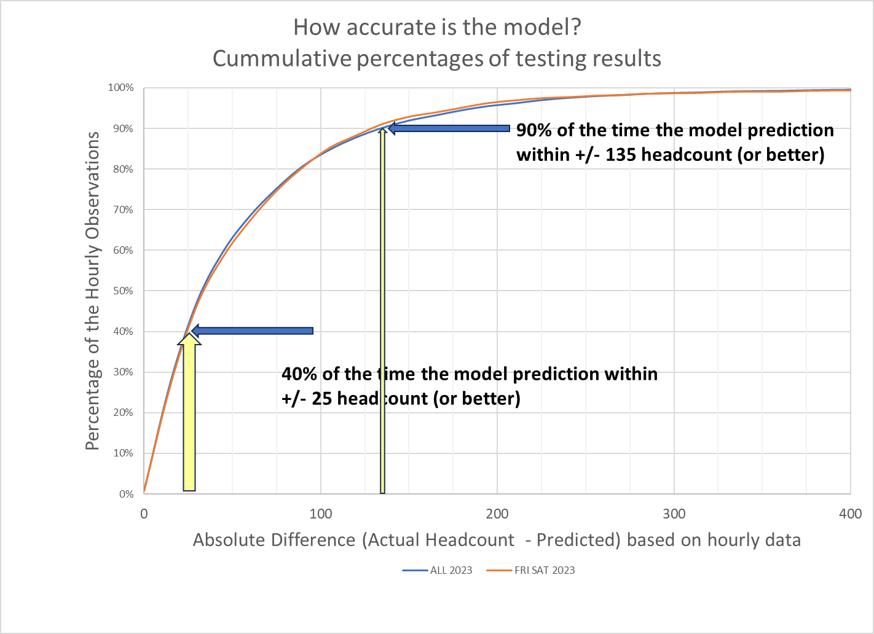
Error Distribution
Notes:
Dio

Slide 20
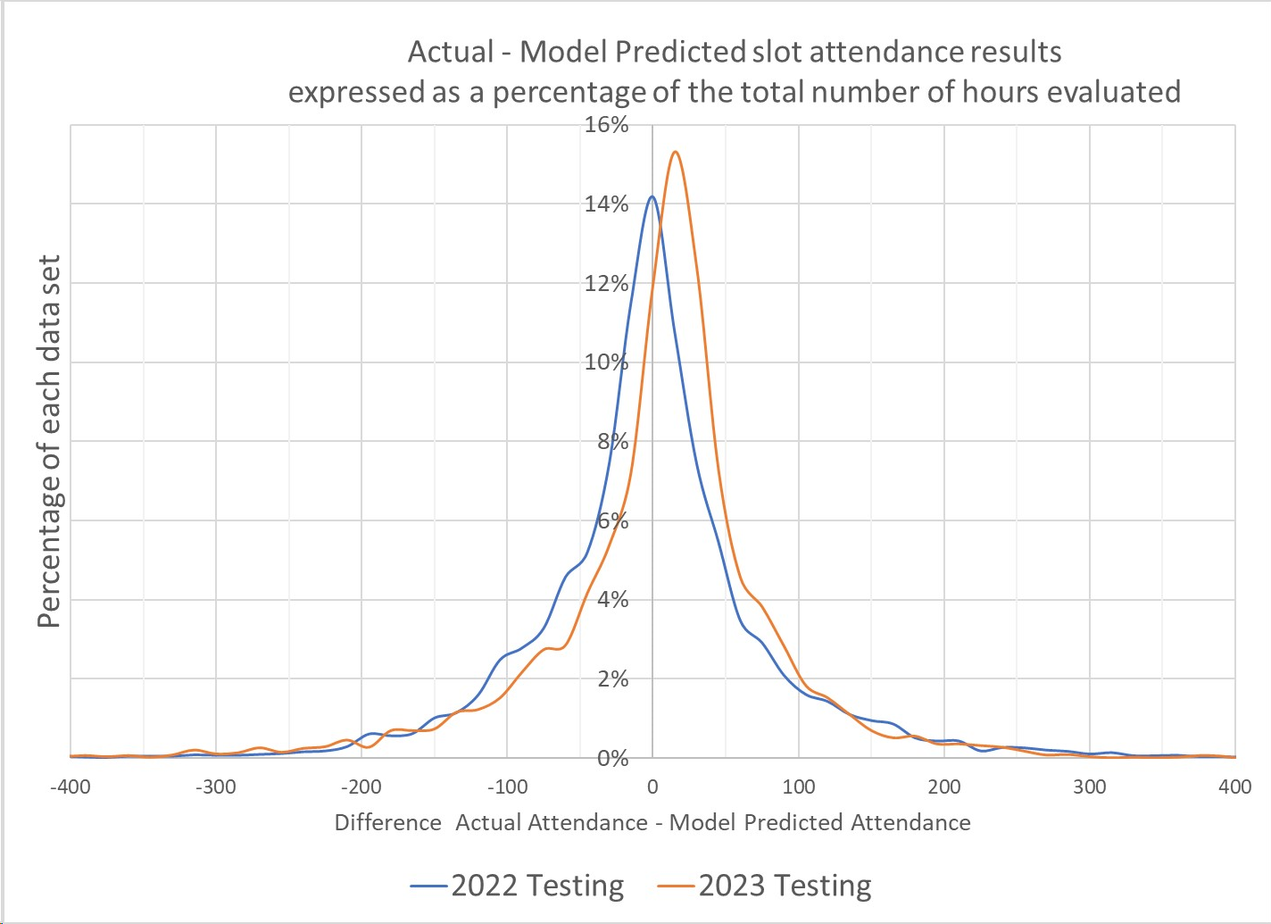
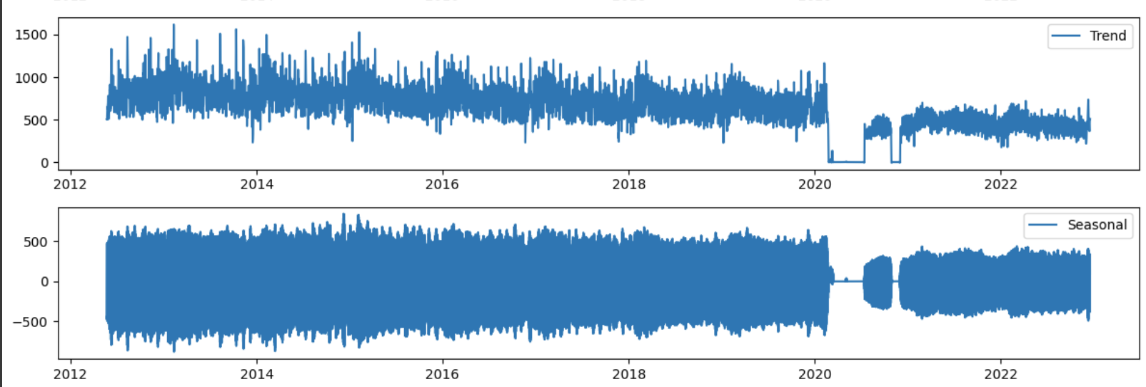
Results (2022 vs 2023)
Overall there is a slight downward trend in headcount from 2012-2023. Our model slightly overpredicts in 2023, which is to be expected due to this downward trend.
Notes:
Donglin
In this slide, we see the graph on the left showcasing our model's predictions from May 21 to June 3. Notice how closely the predicted values (in orange) mirror the actual headcount (in blue). This tight correlation suggests that during this period, our model was highly effective, likely due to stable patterns that the model learned well.
the graph on the right from February 26 to March 11 illustrates a period of less accurate predictions. The divergence between the actual and predicted values is significantly wider, which could indicate the presence of unforeseen factors that the model couldn't account for, or perhaps a shift in patterns not captured in the training data."

Slide 21
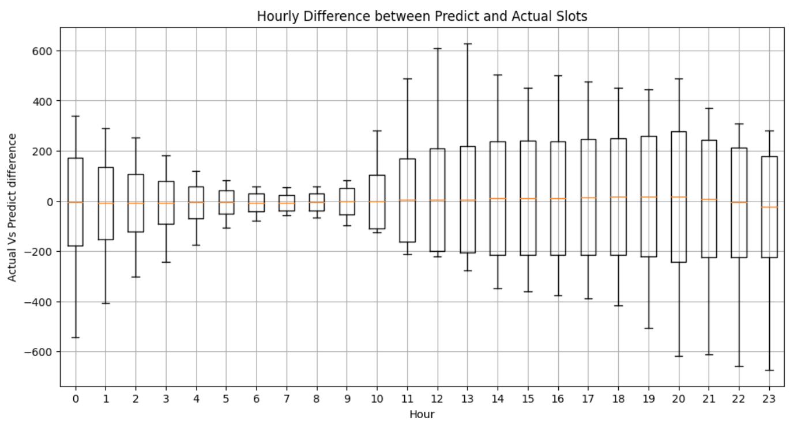
Results (Hours)
Average Hourly Difference between Predicted and Actual Slot Headcount
Boxplot Explanation:
Yellow bar: mean
Upper bound and lower bound of box: 95% of entire data
Whisker:
Max and Min of hourly Actual - Predict
Errors relatively similar from Noon to 10pm
Actual- Predict Headcount
Hour
Notes:
Lingxiao
Describe y label, x label, test period, yellow line, 5-95 percent box upper bound and lower bound, whisker meaning.
We can see that the distribution can be categorized into 2 different sets, shorter distribution and longer distribution

Slide 22
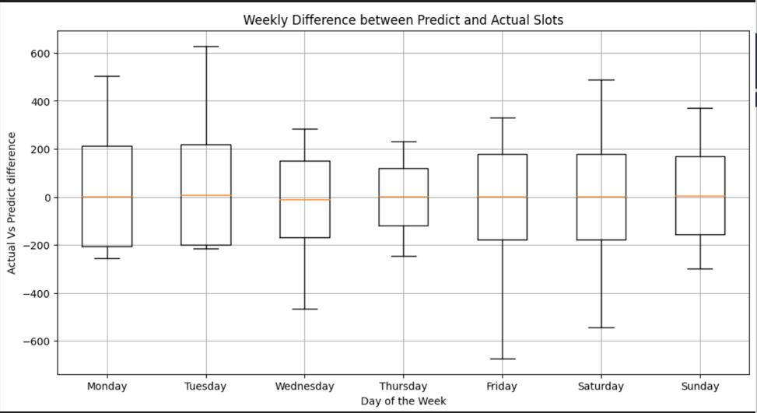
Results (Days)
Average Daily Difference between Predicted and Actual Slot Headcount
Actual - Prediction Headcount
Day of the Week
Notes:
dio

Slide 23
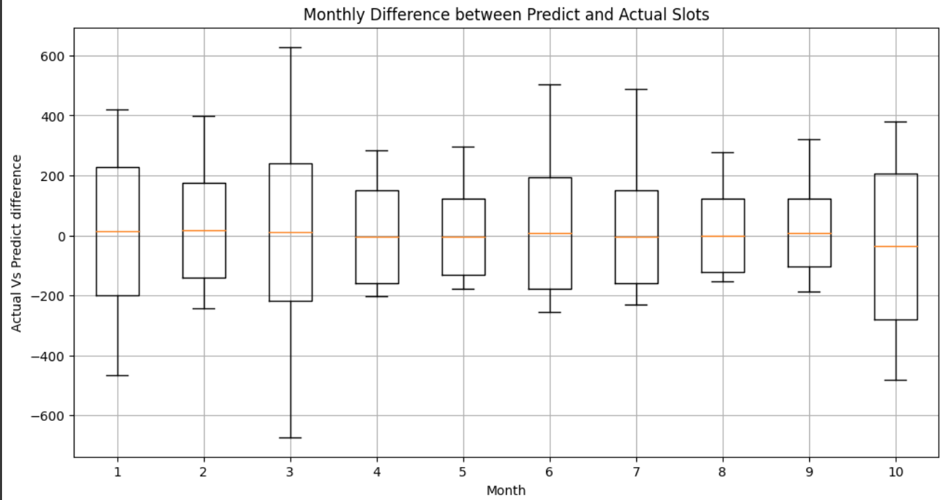
Results (Months)
Average Monthly Difference between Predicted and Actual Slot Headcount
Actual - Prediction Headcount
Month
Notes:
dio
The box plot shows the monthly difference between predicted and actual slot headcounts over a year.The spread of each box and its whiskers reveal the variability in prediction accuracy, suggesting that the model's performance fluctuates monthly, potentially due to seasonal influences or dataset limitations.

Slide 24
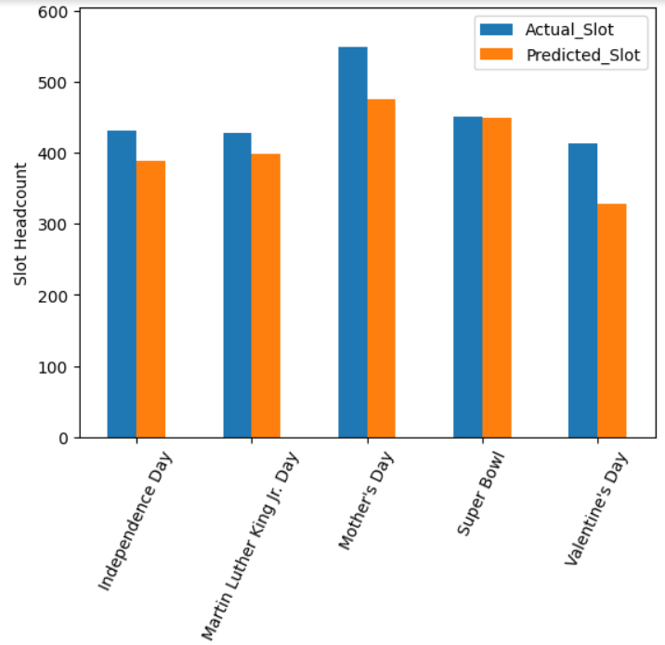
Holiday Analysis (2023)
On average, all holidays have close predictions
The y axis shows the average headcount for the specific holiday. The average of the prediction is shown with orange while the average for actual is in blue
Notes:
sandy

Slide 25
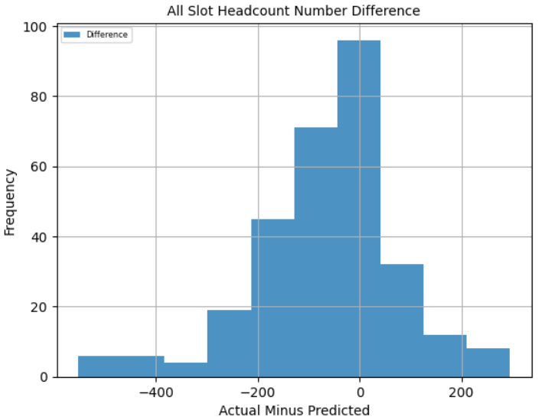
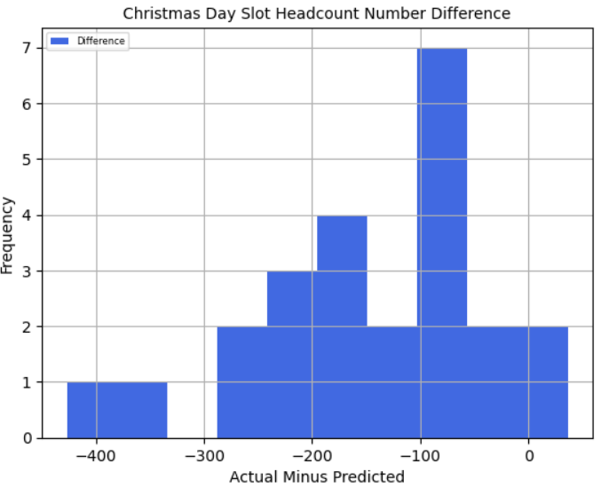
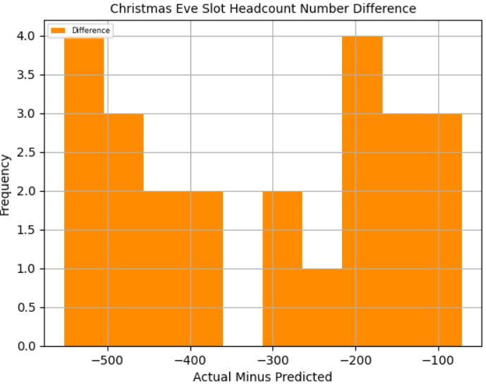
Christmas (2022)
Based on the training data from 2022, our model severely overpredicted Christmas and Christmas Eve. We expect our model to have similar results for Christmas and Christmas Eve for 2023
Christmas
Christmas Eve
‹#›
Notes:
sandy

Slide 26
Opportunities
Opportunities to Utilize the Model
Aid WFM in schedule development
Tool could be used for planning and analysing marketing campaigns
May be able to increase the efficiency of food and supply orders
Daily / weekly briefing for staff
Notes:
sandy

Slide 27
Recommended Next Steps
Develop Api for Model Usage
Input timeframe for prediction and data and outputs prediction
Add optionality for routine data updates and monitoring systems
Impact / Why
Allow building of applications that use model predictions
Make prevent model drift by periodically updating testing data
Notes:
Nathan

Slide 28
Recommended Next Steps
Enhance the Model For Short-Term Predictions
Re-introduce weather variable
Lag variables over shorter timespan given the new data known
Impact / Why
Weather data provides an additional signal impacting attendance
Better short-term prediction performance that can be used for
Day / Week in review
Last minute schedule changes
not replacing someone who called off, calling someone in, etc
Notes:
Nathan

Slide 29
Recommended Next Steps
Investigate Holiday Attendance Trends
The model has difficulties predicting certain holidays
An independent analysis of past holliday attendance patterns could provide a better prediction than most models (due to limited training data)
Impact / Why
Model is bad at predicting holidays
Better holiday predictions
Useful information for marketing and promotion creation
More efficient scheduling during these periods
Notes:
Nathan

Slide 30
Thank You!
Any Questions?

Slide 31
Appendix
Accompanying Material
Previous Slides
Notes:
Nathan

Slide 32
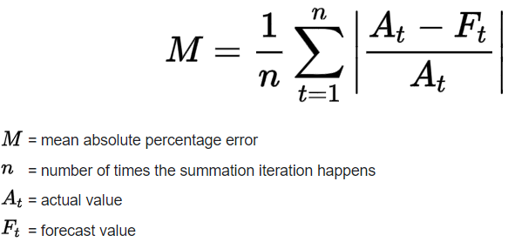
MAPE Formula

Slide 33
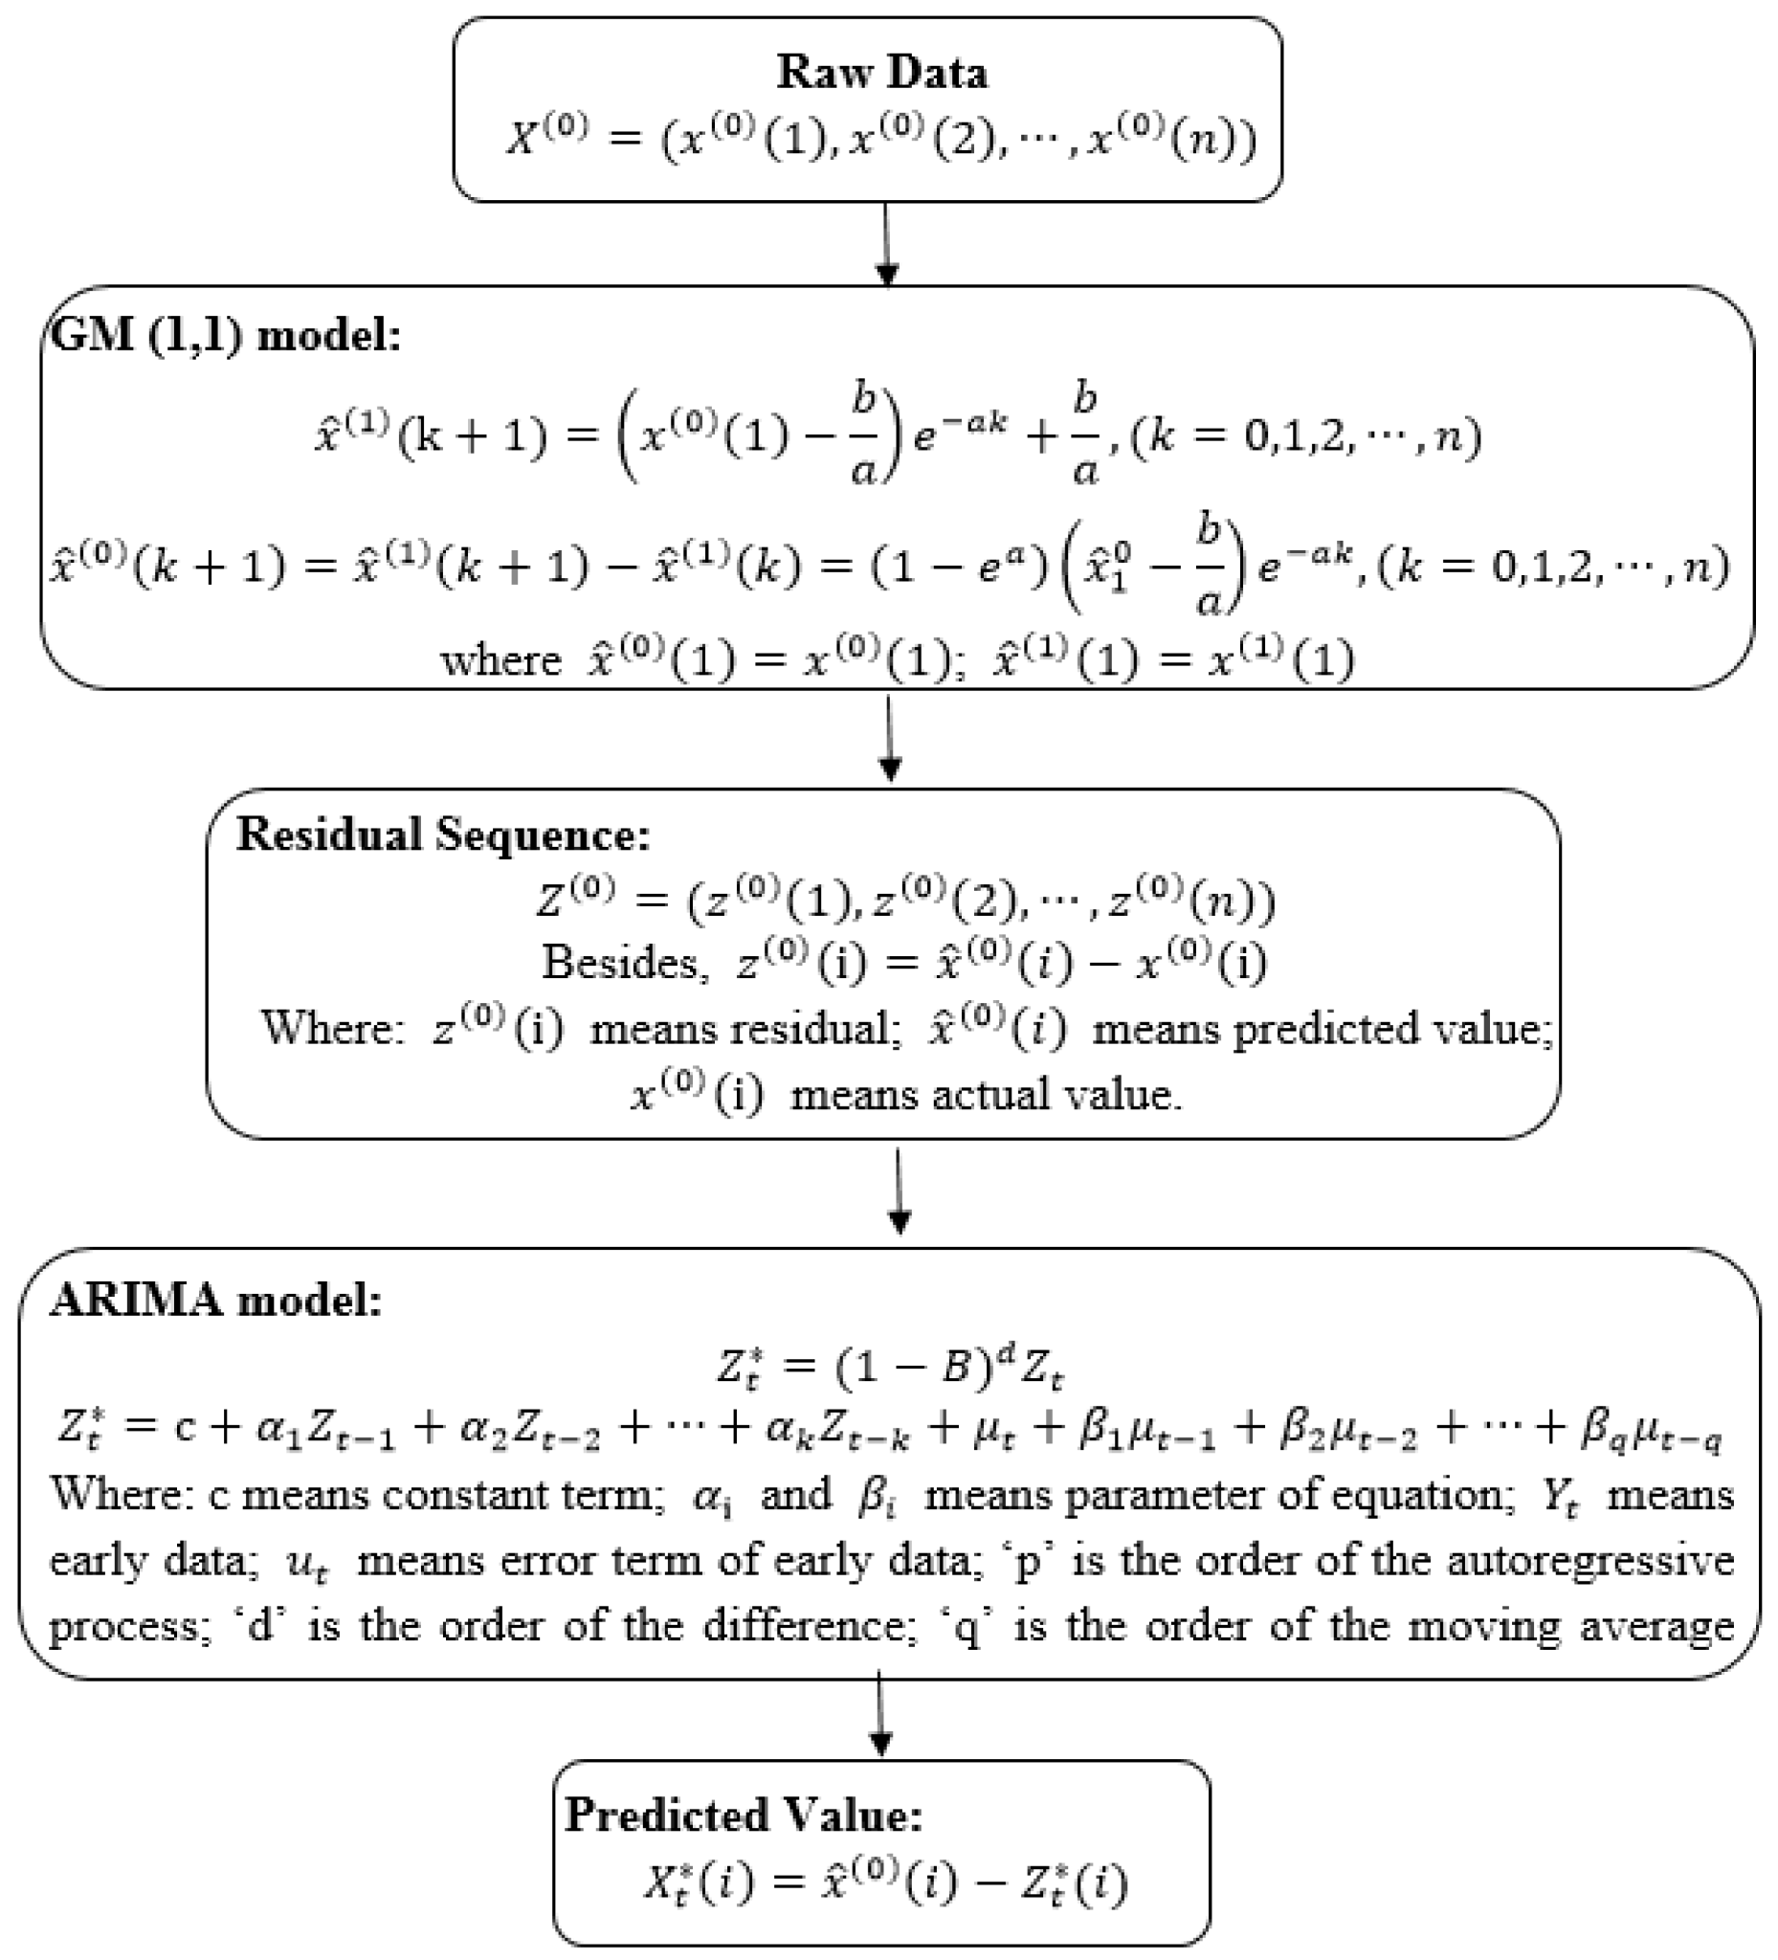
AutoARIMA
Autoregressive
Variable of interest is regressed on its own lagged values
Differencing
Replace data values with the difference between their values and the previous values
Can be done more than once
Moving Average
Average value and previous values
t+1 MA shifts the values included forward by 1
Pros:
Great short-term predictions
Autoselection of hyperparameters
Cons:
Longer runtime
Bad with seasonal and multi-seasonal data
Often Used Industry for:
Stock Price Predictions
Mape ~4%
Notes:
Nathan & Dio

Slide 34
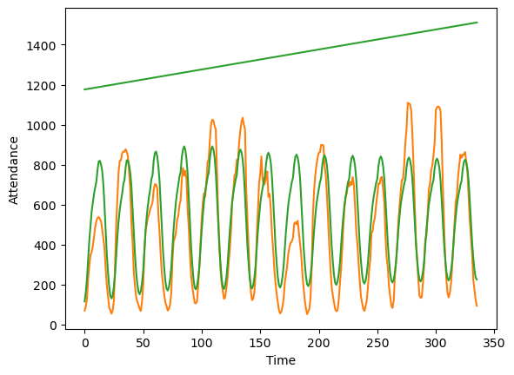
AutoARIMA(First Round)
AutoARIMA (Auto-Regressive Integrated Moving Average)
Model:
Moving Average
Series of Averages
Regression
Lagged Observations
Differencing
Remove stationarity
Results:
Long runtime
expecting over 200 hours for 1 training
Failed to converge on adequate solution
Manual selection of parameters
Difficult time handling multi-seasonality
Best 2-week MAPE: 41%
Orange– Actual headcount
Green– Predicted headcount
Notes:
Nathan & Dio

Slide 35
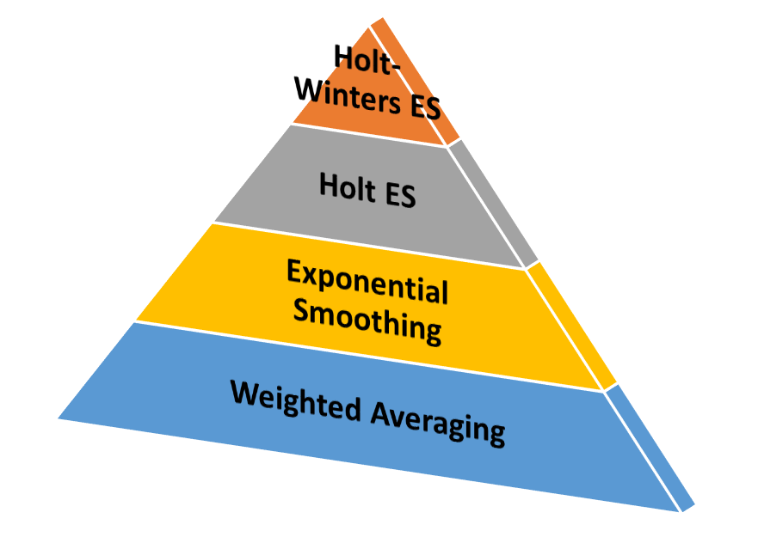
Holt-Winters Exponential Smoothing
Weighted average of past observations to predict future points
More recent observations more relevant than older observations
3 smoothing factors - level of series, trend, seasonality
Multiplicative model (changing mean)
Pros
Easy to understand and implement
Code easily found online
Computationally efficient
Can handle missing data points and outliers
Cons
Not the best with complex data or structural changes in time series
Cannot handle multivariate time series data
Has been successfully used for
Predicting CPU usage
Forecasting water demand
Notes:
Sonia, Sandy & Donglin

Slide 36
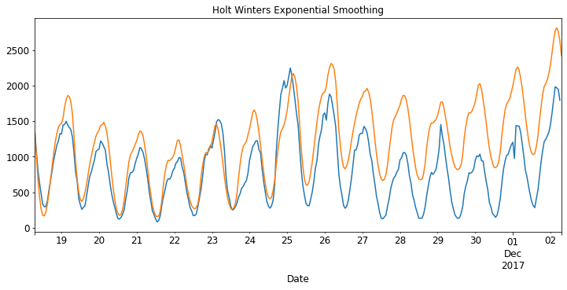
Exponential Smoothing (First Round)
Holt-Winters Exponential Smoothing
Plot 1. Plot showing the prediction of headcount(in yellow) and actual value of headcount (blue) using HWES model
Time series model that include trend and seasonality
Easy to implement
Univariate, cannot add more variables
Prediction Period | MAPE (%)
1 shift / 8 hours | 28.02
1 day | 25.93
1 week | 53.59
2 weeks | 42.97
‹#›
Notes:
Sonia, Sandy & Donglin

Slide 37
Random Forest (Second round)
Split data on classification features until reaching a leaf node
Multiple trees, each tree trains dataset on different subsets of data
Final decision takes average of prediction from all trees
Pros
High accuracy
Code easily found online
Low chance of data overfitting
Can handle missing data points and outliers
Cons
Low interpretability
Slow run time
Past Use:
Patient Outcome Prediction (Yang et al., 2019)
Notes:
Sandy & Sonia

Slide 38
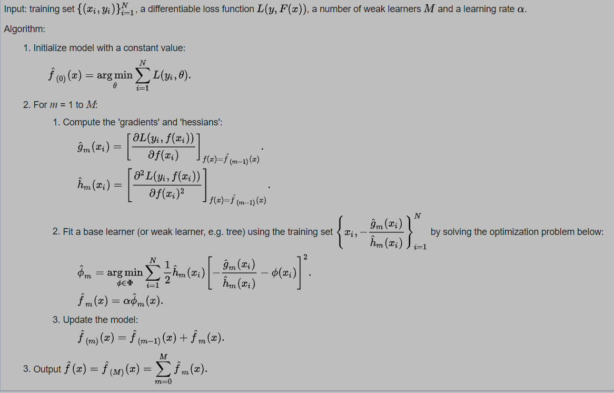
XGBoost - eXtreme Gradient Boosting
Many decision trees
New trees focus on the incorrect predictions of previous models
Add models until accuracy doesn’t improve
Final prediction is a weighted average of all the models
Better accuracy → higher weight
Pros:
Fast and Accurate
Cons:
Prone to overfitting
Successful Past Uses:
Prediction of Covid cases
Mape: 8%
Notes:
Nathan

Slide 39
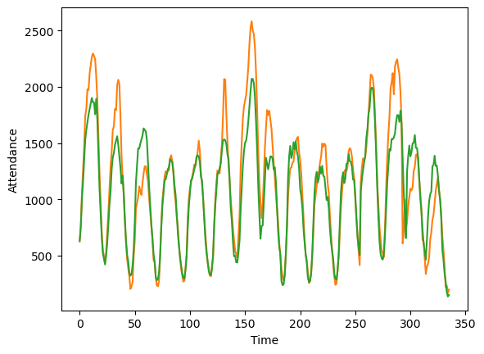
XGBoost (Second Round)
XGBoost:
Gradient boosting
Multiple weak models (decision trees)
Missed datapoints weighted higher
Ensemble of models for final prediction
Overfitting deterrents
Regularization and early stopping
XGBoost Results
Prediction Period | Mape(%)
8 hours | 9
1 day | 13.1
1 week | 14.6
2 weeks | 15.8
Without:
Holidays
Sports
Promos/CRM offers
Graph:
Orange– Actual headcount
Green– Predicted headcount
‹#›
Notes:
Nathan

Slide 40
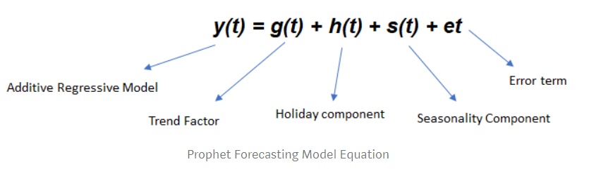
Prophet
Advantages:
Easy-to-use: It has a simple and intuitive API, making it easy for non-experts to implement time series forecasting.
Handles seasonality and holidays: It can automatically model and forecast time series data with various seasonal patterns and holiday effects.
Robust to outliers and missing data: It is less sensitive to outliers and can handle missing data points without the need for manual imputation.
Scalability: It can scale to large datasets and perform well on time series with long-range forecasts.
Disadvantages:
Less accurate for high-frequency data: Prophet may not perform as well on high-frequency data, like intraday or minute-level time series, as it is optimized for daily or weekly data.
Use cases:
Time series problem (Since Prophet is only design for time series.)
Notes:
Donglin

Slide 41
Prophet
Q: Why would this method less accurate on high-frequency data? If those inputs could be defined on intradaily basis, what about this forces it to be weekly or daily?
A: It is true that the model itself can apply any time scale, however, the default setting for Prophet is to set as a low-frequency seasonality(Weekly, daily, or Monthly). Prophet is an additive model which may not hold for high-frequency data since in intradaily basis input, the relationship between different time periods might be more complicated, or even a nonlinear relationship. Also, the default setting for the Prophet model is a weekly basis or daily basis, so if we apply high-frequency data it might cause the model to overfit.
Notes:
Donglin

Slide 42
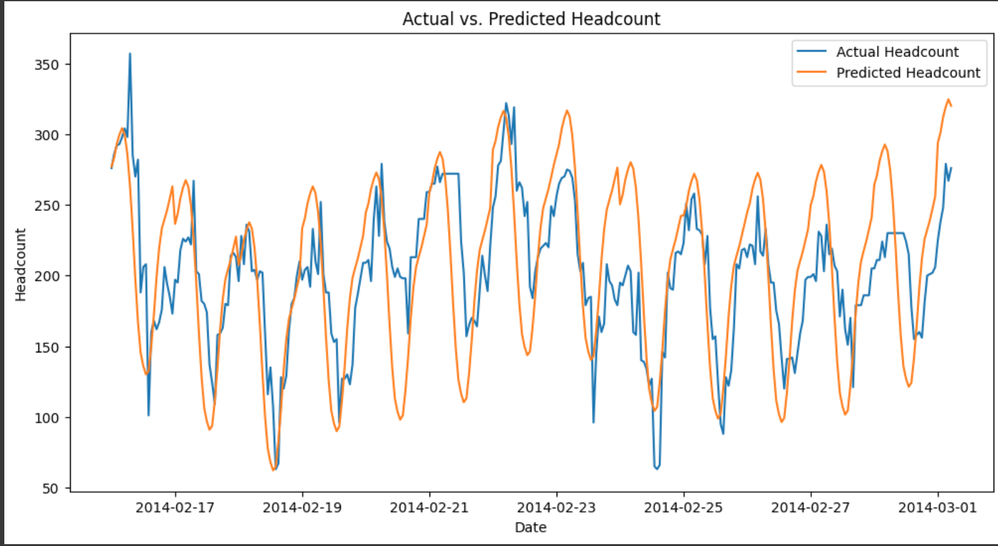
Prophet (Second Round)
Prophet model is a linear model specifically design for the time series forecasting
Pros:
The compute speed is fast.
Can handle large dataset and multiple seasonalities
Prophet result
Prediction Period | MAPE(%)
8 hours | 4.45
1 day | 20.26
1 week | 19.05
2 weeks | 20.02
‹#›
Notes:
Donglin

Slide 43
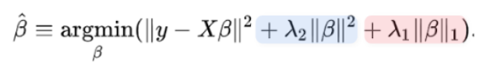
Elastic Net
Definition:
beta : the coefficient of the input feature.
Y: the actual target value. Lambda1 and lambda2 are user defined variables
The first term in the loss function is the mean squared error between the predicted and actual target values, which is minimized by adjusting the coefficients w. The second term is the regularization term that encourages sparsity in the coefficient vector w by shrinking its values towards zero. The L1 regularization term (l1_ratio * ||w||_1) promotes sparsity by setting some of the coefficients to exactly zero, while the L2 regularization term ((1 - l1_ratio) * ||w||_2^2) encourages small but non-zero coefficients.
Advantage:
L1 regularization(lambda 1) can lead to coefficient sparsity but can also be unstable and select only one variable when many are highly correlated, which leads to good model.
L2 regularization(lambda 2) can overcome this by shrinking all correlated variables together, but can also lead to overfitting if the number of features is large. The Elastic Net model strikes a balance between these two methods and can handle a large number of features while promoting sparsity and stability. Good sparsity and stability gives good model.
Reduce variance
feature selection strategy has been implemented and ranks features based on their contribution to the model
Disadvantage: Linear relationship assumption.
Use cases:Linear Regression problem, time series(Energy consumption for 5 years)
Notes:
Dio

Slide 44
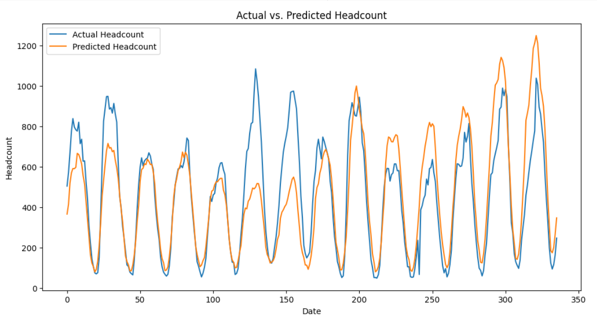
Elastic Net (Second Round)
Definition
Linear regression
Regularized parameter
Feature selection
Pros:
Select features.
Cons:
Not flexible or only used for linear distribution of data.
Prediction Time MAPE (%)
8 hours | 34
24 hours | 38
1 week | 158
2 weeks | 98
‹#›
Notes:
Dio

Slide 45
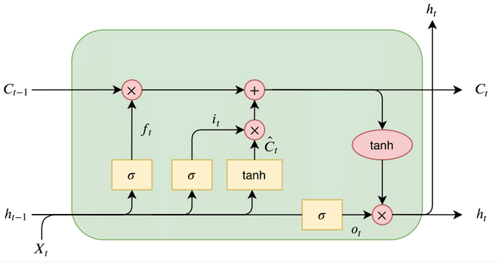
LSTM - Long Short-Term Memory Networks
Forget Gate
Input Gate
State Update
Output gate
‹#›
Notes:
Dio

Slide 46
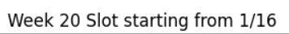
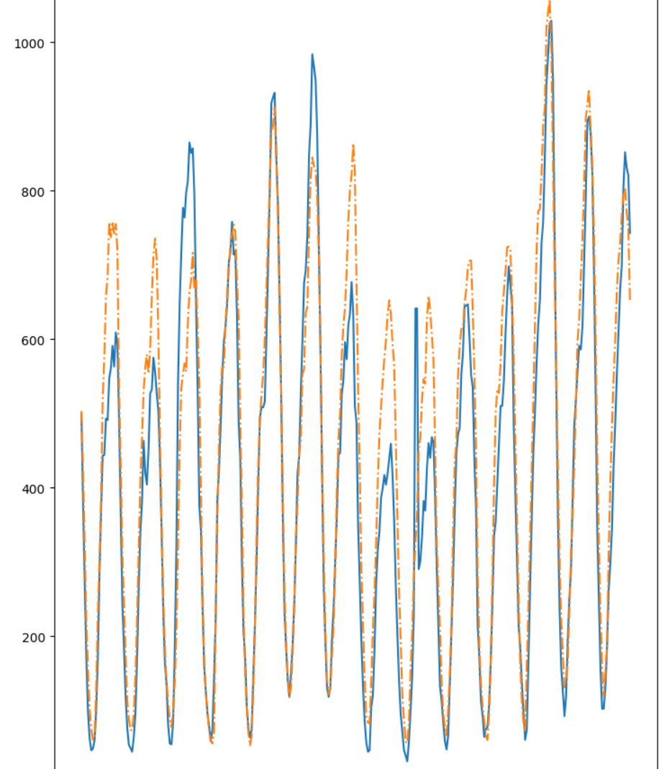
LSTM (Third Round)
MAPE Score
2 weeks: 0.35
2 weeks: 0.4
‹#›
Notes:
Dio

Slide 47
Data Leakage
“Attendance”
“STL Decomposition”
“Single-step prediction”
How project scope has changed

Slide 48
Variables
Tables: # of Tables at Casino
Carded: Carded guests
Total: Slot Machine Headcounts
Proportion: Tax_proportion (From Sonia)
BKAP: Detroit Away Games
BSAP: Detroit Away Games
FAP: Detroit Away Games
HAP: Detroit Away Games
BKAR: Detroit Away Games
BSAR: Detroit Away Games
FAR: Detroit Away Games
HAR: Detroit Away Games
Promo: Promo1
Type: Promo1 type
Cost: promo1 cost
Revenue: Promo1 Revenue
Promo2: Promo2
Promo3: Promo2
OpenTables: # of Tables opened at Casino
Headcount: Table Headcounts
Uncarded: Uncarded guests
Umscent: U of M Consumer Sentiment Index

Slide 49
Consumer Sentiment
The UMich consumer sentiment index measures the consumers confidence in the economy.
It considers elements such as: inflation, consumer surveys, excess savings, etc
Link to data: http://www.sca.isr.umich.edu/

Slide 50
Weather
https://drive.google.com/drive/folders/1jNK8_O7Lebj_4Tu57hHd6ShV9gfd2QWF?usp=drive_link

Slide 51
Seasonal and Trend Graph

Slide 52
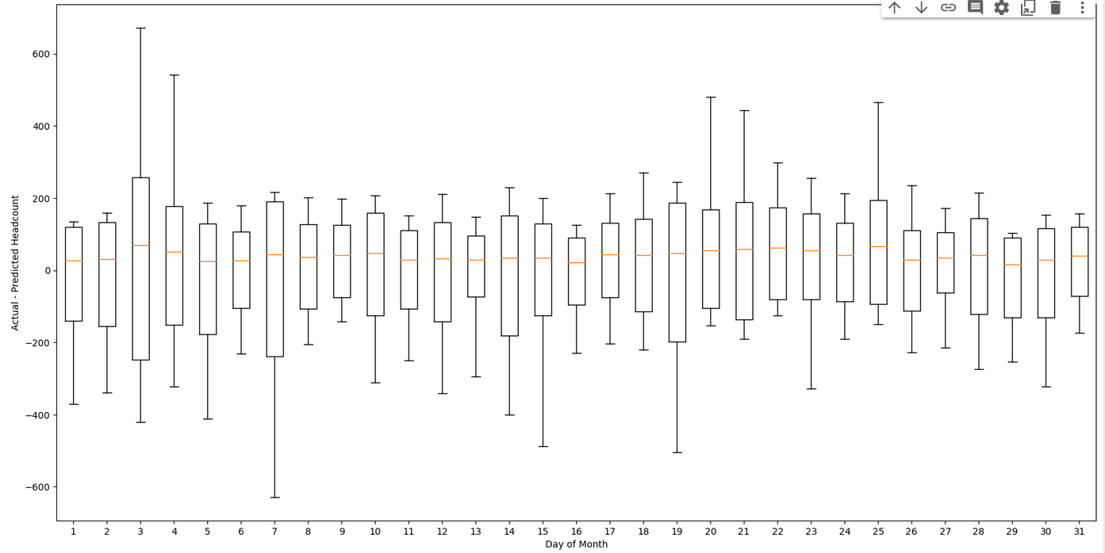
Aggregated Day of Month Headcount Distribution
Generally, 95% of the predictions falls within (-200,200) on average
Example of looking at data:
For all 1st day of month, 95% of headcount difference falls within (-150,150) range
Best day: 13th, worst day 3rd

Slide 53
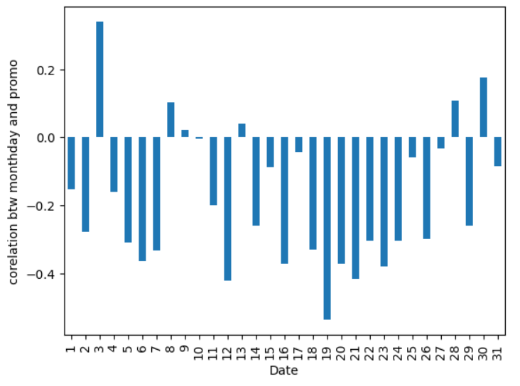
It plots the correlation between (whether there is promo) and Predict-Actual on each day of month
High correlation score does not guarantee short difference distribution range
Nothing we can conclude here

Slide 54
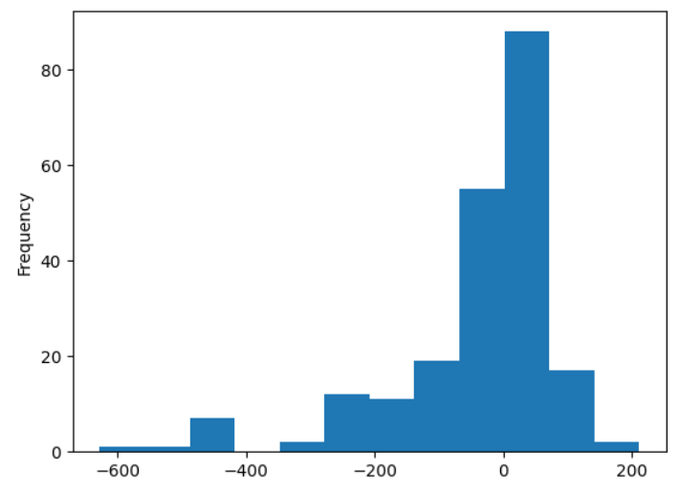
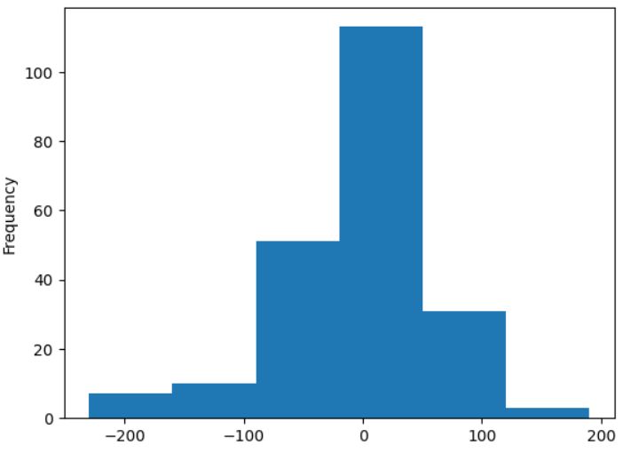
Day of Month Detail Break Down
Day 7 of month Distribution plot(Worst day)
Day 6 of month Distribution plot(Best Day)

Slide 55
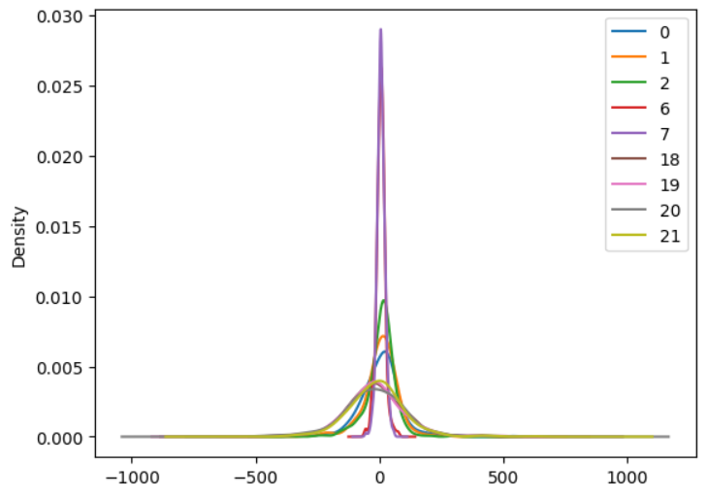
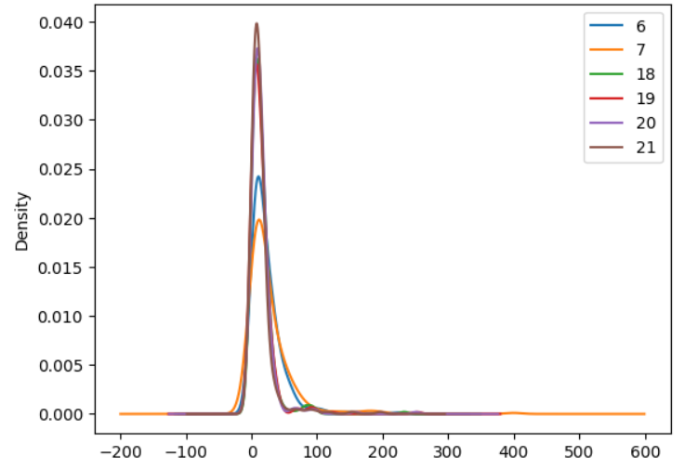
Difference Distribution Comparison Graph for each Hour
Percentage Difference Distribution Comparison Graph for certain hour
Actual - Predict
(Actual - Predict)/Actual * 100%
Density is the same as frequency of specific headcount interval.
Achieve low difference during low headcount period(hour 6,7) while having low percentage differences during high headcount hours(hour 18~20)

Slide 56
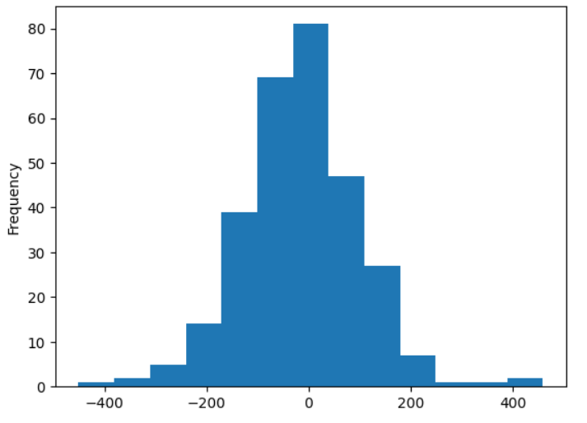
Hour 18 Year 2023 Distribution
Each bin has size of 70 headcount difference
Check slide 12 for hour 18’s 95% percent distribution
Actual - Prediction

Slide 57
Standard deviation of error
Baseline
Standard Deviation: 103
95% Confidence Interval:
[pred- 202, pred+ 202]
Random Forest
Standard Deviation: 89
95% Confidence Interval
[pred - 174, pred + 174]

Slide 58
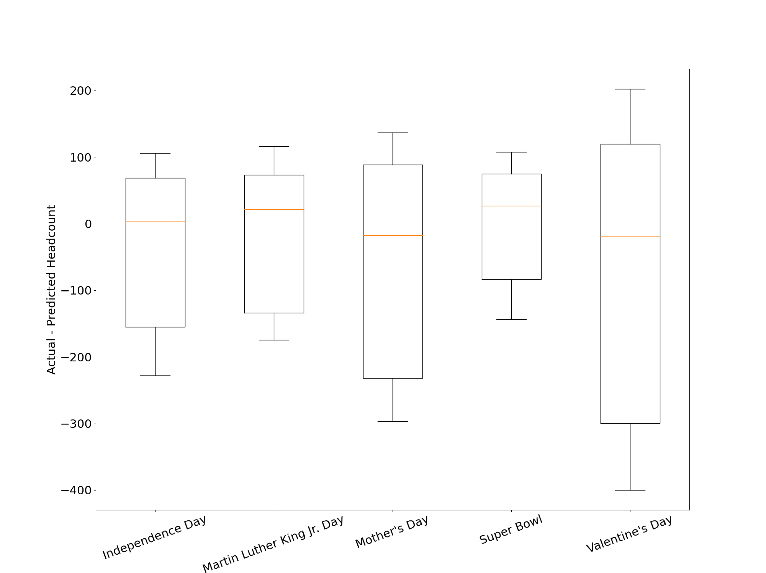
Holiday Distribution (2023)
Whisker:[0:100], boxplot upper and lower bound:[0.025,0.975]
Overall: Christmas Day and Christmas Eve are the ones that deviates the most from the 0 difference. They are the worst prediction period

Slide 59
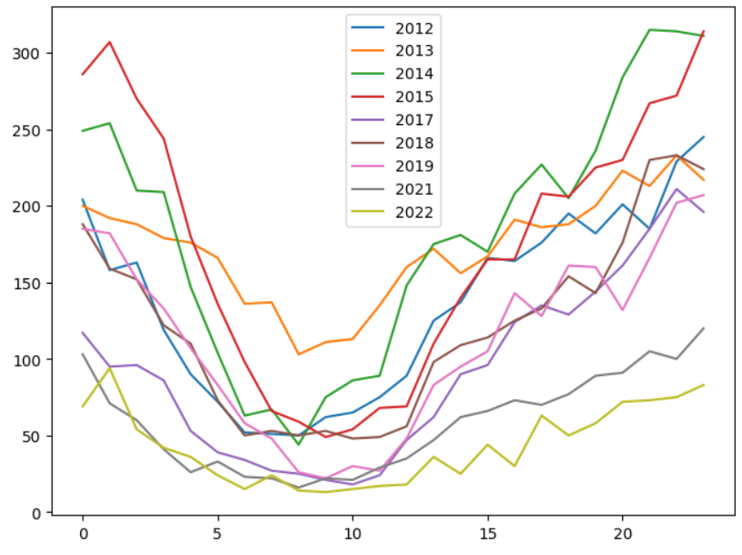
Historical Christmas Headcount
2021 and 2022 Christmas Headcount values are generally lower values than historical headcount values.

Slide 60
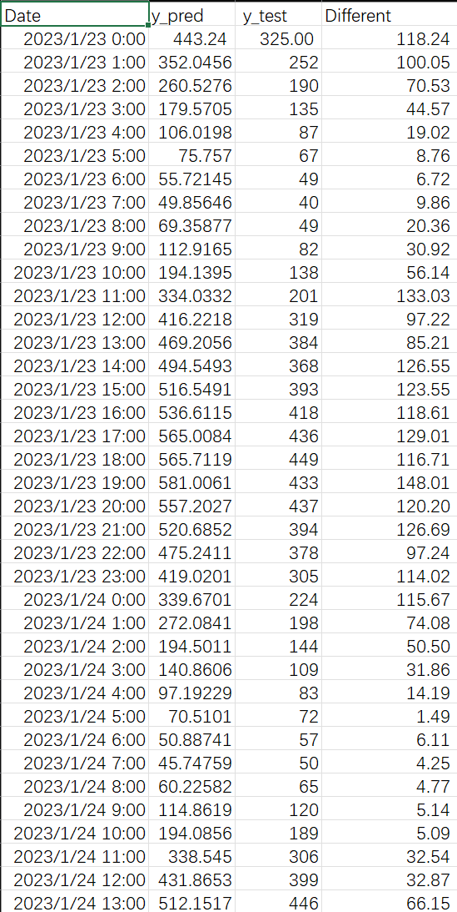
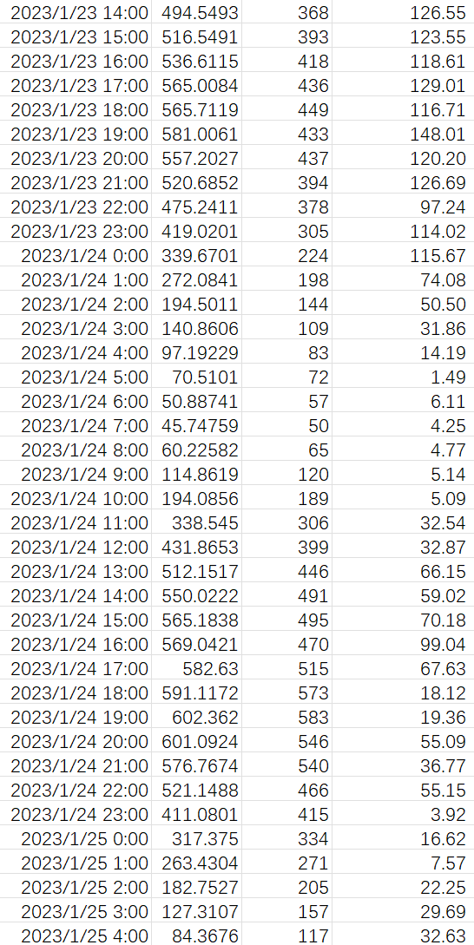
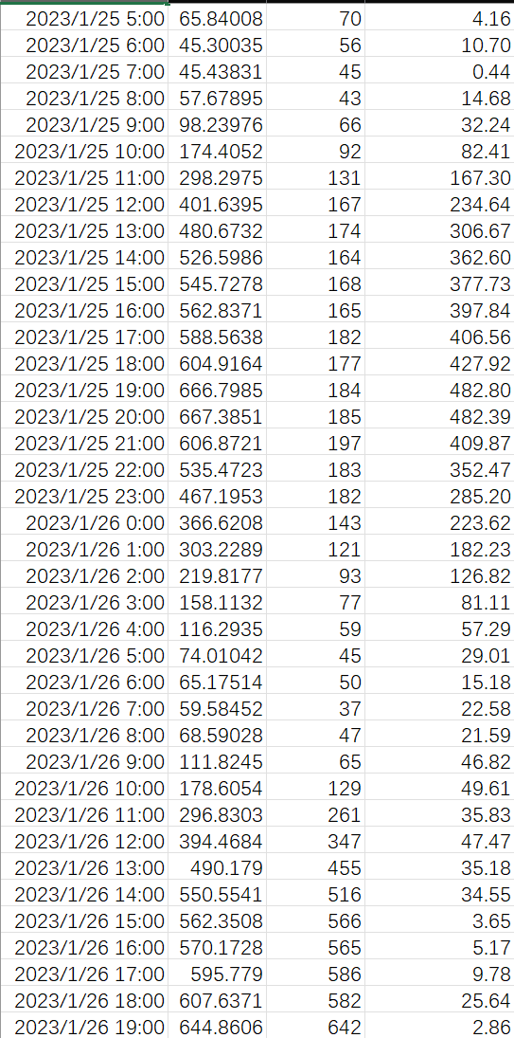
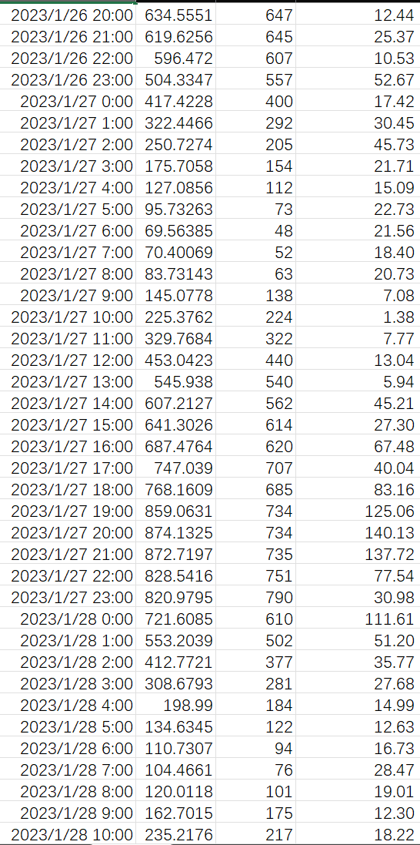
Best performance

Slide 61

Best Performance

Slide 62




Worst Prediction

Slide 63
Bibliography
Brownlee, J. (2020, October 7). How to Develop Elastic Net Regression Models in Python. Machine Learning Mastery. https://machinelearningmastery.com/elastic-net-regression-in-python/
Liberman, N. (2017, January 26). Decision Trees and Random Forests. Retrieved from https://towardsdatascience.com/decision-trees-and-random-forests-df0c3123f991
Meltzer, R. (2021, July 15). What Is Random Forest? Retrieved from https://careerfoundry.com/en/blog/ data-analytics/what-is-random-forest/#:~:text=2.,group%20than%20they%20do%20alone
Pawar, P. (2020, June 8). Predicting Hourly Energy consumption of San Diego — II. Towards Data Science. https://towardsdatascience.com/part-2-time-series-analysis-predicting-hourly-energy-consumption-of-san-diego-ii-f09665796c9
Yang, S., Zhengy, X., & Yuan, F. (2019). A Patient Outcome Prediction based on Random Forest. Association for Computing Machinery, 220–227. https://doi.org/10.1145/3371238.3371272

